Slide 1
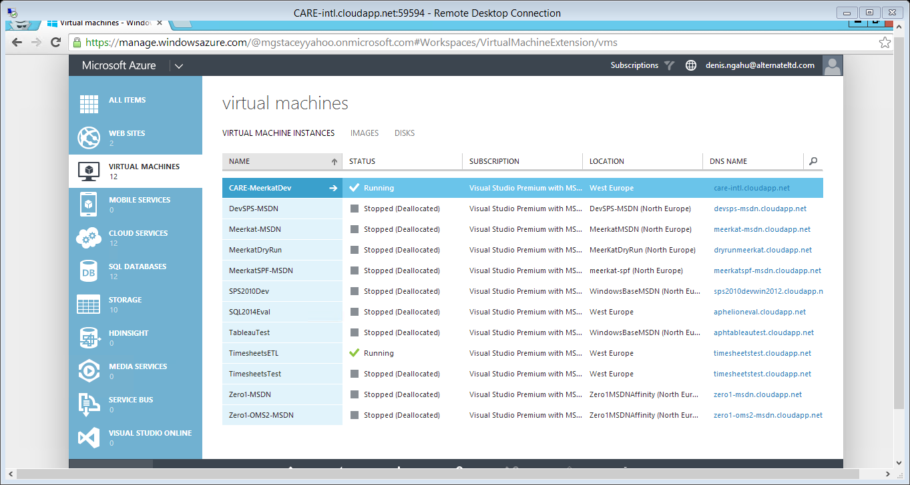
Click on the arrow next to the machine you want to add an endpoint to.

Slide 2
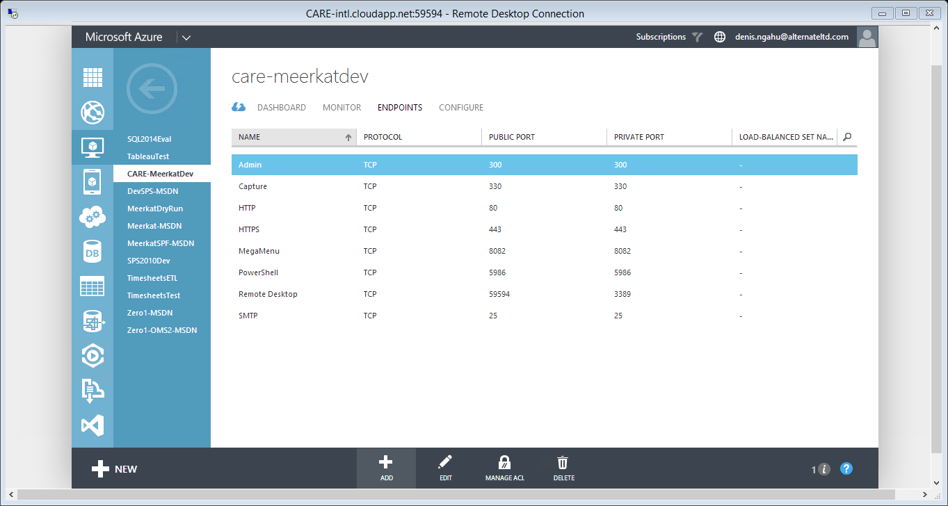
Click on endpoints and then click on add.

Slide 3
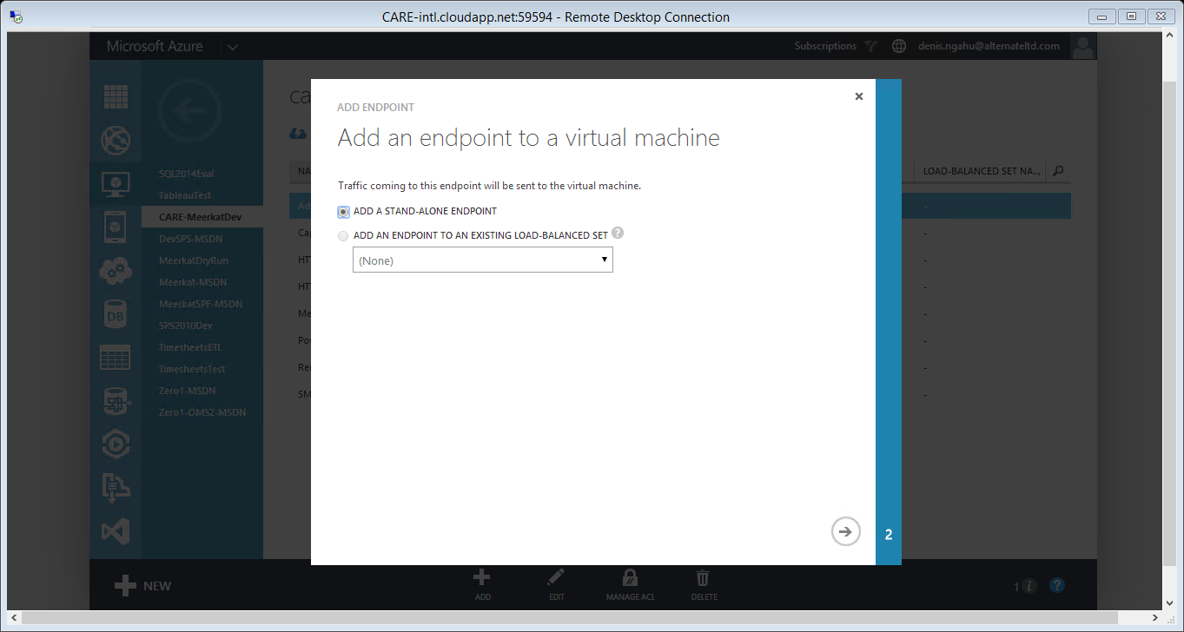
Select add a standalone endpoint and then click the arrow at the bottom right of the page.

Slide 4
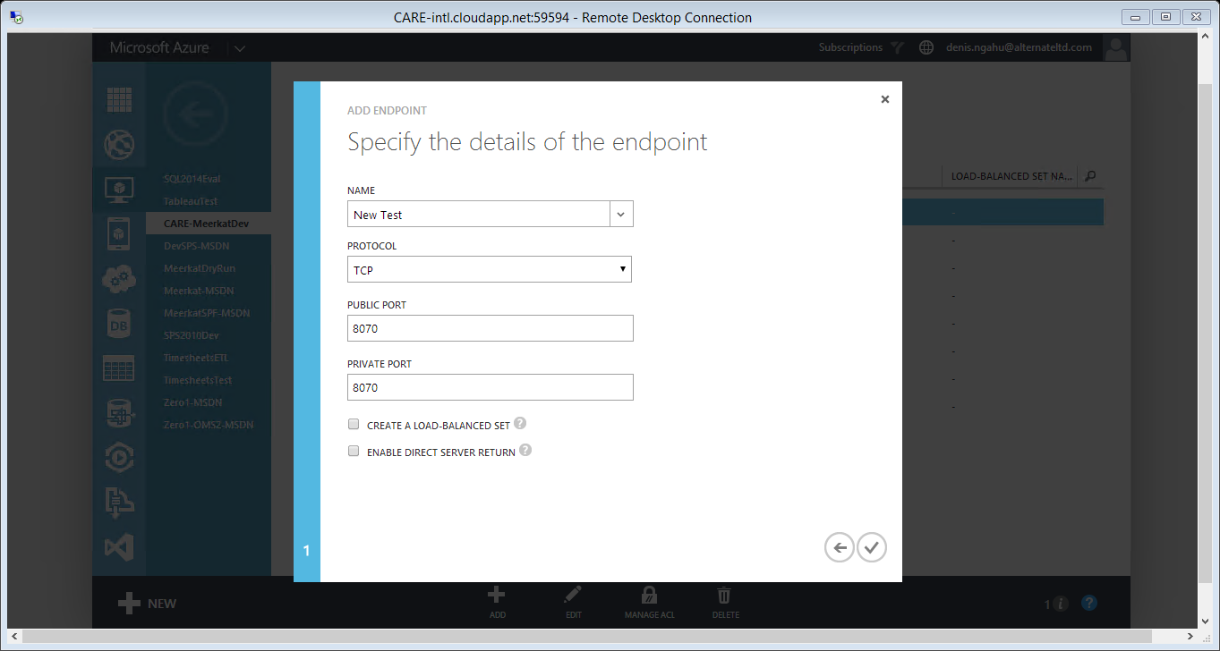
Fill out the details and then click on the tick at the bottom right of the dialog to accept the settings.
NB: The public and private port must have the same value.

Slide 5
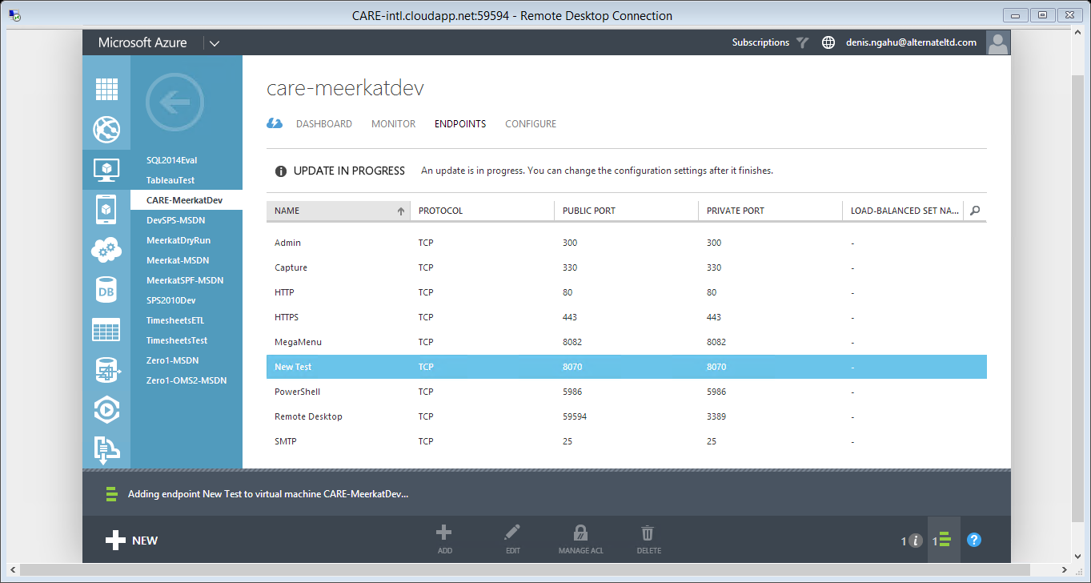
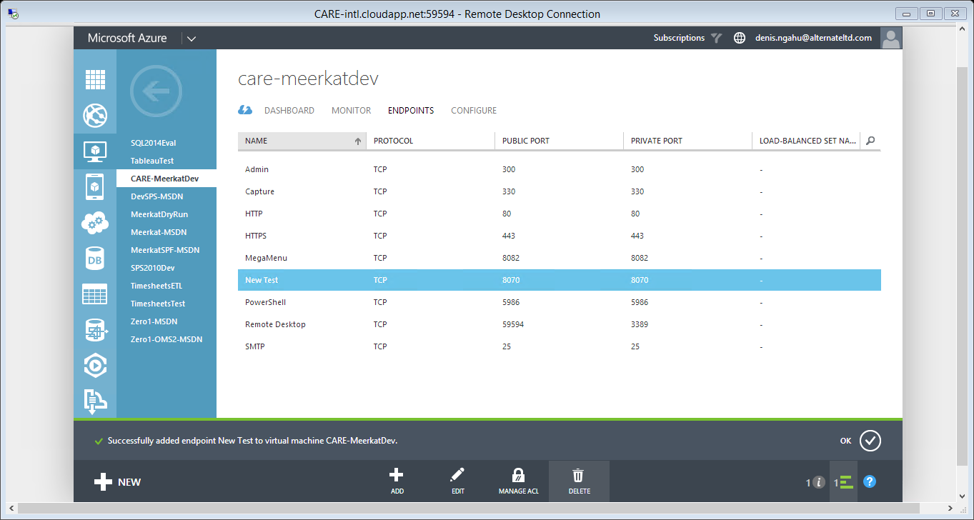
Once the virtual machine changes are complete, click on ok. At this point, you can either go back to the virtual machines or repeat the process to add another endpoint.

